Slide 1

LLM,s Memory and Compute Optimizations

Slide 2
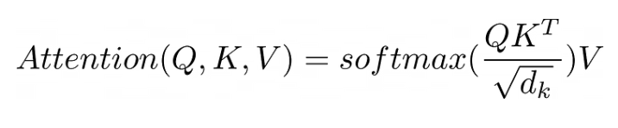
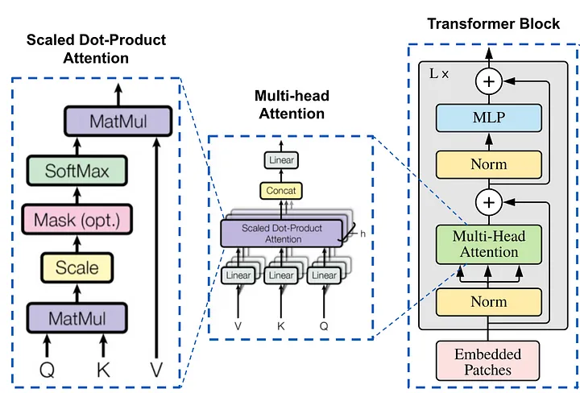


Optimizing the Self-Attention Layers (Attention mechanism)
Q: Vector(Linear layer output) related with what we encode(output, it can be output of encoder layer or decoder layer)
K: Vector(Linear layer output) related with what we use as input to output.
V: Learned vector(Linear layer output) as a result of calculations, related with input
The basic attention mechanism computes a weighted sum of values, with weights dependent on a query and a set of keys. Mathematically, this is expressed as:
Multi-head attention employs multiple ‘heads’ of attention layers, enabling the model to attend to information from different representation subspaces. In each head, there is an independent set of linear layers (projection matrices) for the query, key, and values
The intuition behind multi-head attention is that by applying the attention mechanism multiple times in parallel, the model can capture different types of relationships in the data.

Slide 3
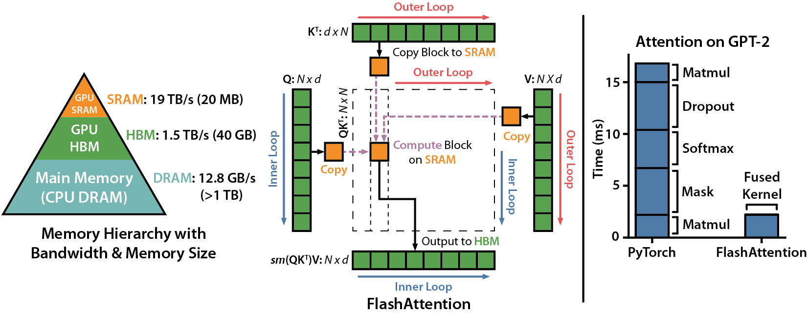
Optimizing the Self-Attention Layers (FlashAttention)
flash-attn library → https://github.com/Dao-AILab/flash-attention/tree/main.
The Transformer’s attention layer is a bottleneck when trying to scale to longer input sequences because the computation and memory requirements scale quadratically O(n2) with the number of input tokens. FlashAttention is a GPU-specific solution to this quadratic scaling problem.
FlashAttention, on version 2 as of this writing, reduces the amount of reads and writes between GPU main memory, called high-bandwidth memory (HBM), and the much faster but smaller on-chip GPU static RAM (SRAM). Despite its name, the
GPU high-bandwidth memory is an order of magnitude slower than the on-chip GPU SRAM.
Flash Attention’s algorithm can be summarized in two main ideas: tiling and re-computation.
Tiling: During both forward and backward passes, Flash Attention divides the attention matrices into smaller blocks, optimizing memory usage and improving computation efficiency.
Re-computation :In the backward pass, Flash Attention recomputes attention matrices using stored outputs and softmax normalization statistics, eliminating the need for excessive memory storage.

Slide 4
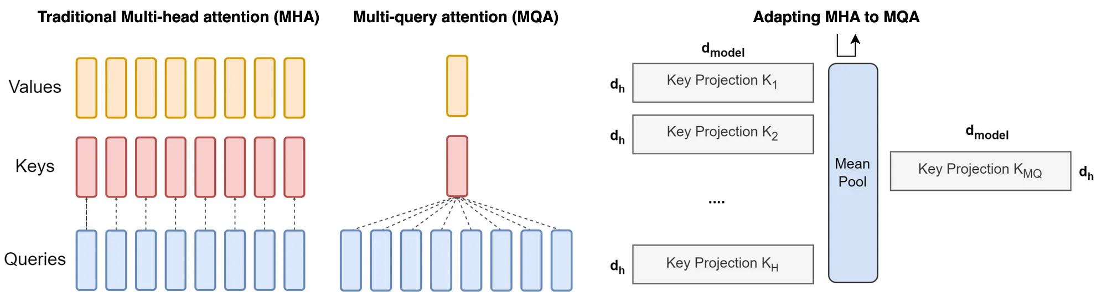
Optimizing the Self-Attention Layers (Grouped-Query Attention) https://arxiv.org/pdf/2307.08691.pdf
The intuition behind multi-head attention is that by applying the attention mechanism multiple times in parallel, the model can capture different types of relationships in the data.
MHA enables a nuanced understanding of the relationships between different parts of the input. Nevertheless, this complexity comes at a cost — a significant demand on memory bandwidth, especially during decoder inference. Each decoding step in autoregressive models like Transformers requires loading decoder weights along with all attention keys and values. This process is not only computationally intensive but also memory bandwidth-intensive
In multi-query attention, we average the heads for keys and values so that all query heads share the same key and value head. This is achieved by replicating the mean-pooled “head” H times, where H is the number of query heads.

Slide 5
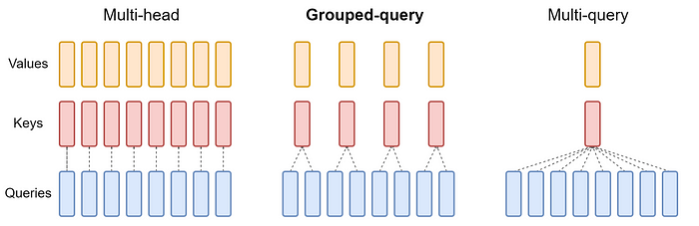
Optimizing the Self-Attention Layers (Grouped-Query Attention) https://arxiv.org/pdf/2307.08691.pdf
Division into Groups: In GQA, the query heads (Q) from a traditional multi-head model are divided into G groups. Each group is assigned a single key (K) and value (V) head. This configuration is denoted as GQA-G, where G represents the number of groups.
Special Cases of GQA:
GQA-1 = MQA: With only one group (G = 1), GQA becomes equivalent to MQA, as there’s only a single key and value head for all query heads.
GQA-H = MHA: When the number of groups equals the number of heads (G = H), GQA behaves like traditional MHA, with each query head having its unique key and value head.

Slide 6
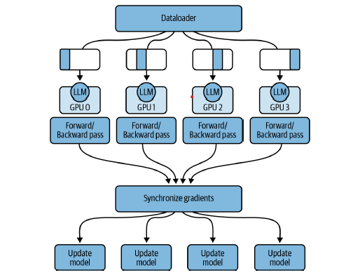
Distributed Computing (Distributed Data Parallel)
DDP automatically copies your model onto each GPU (assuming it fits into a single GPU using a technique such as quantization), splits the data into batches, and sends the batches to each GPU in parallel.
With DDP, each batch of data is processed in parallel on each GPU followed by a synchronization step where the results from each GPU (e.g., gradients) are combined (e.g., averaged). Subsequently, each model—one per GPU—is updated with the combined results and the process continues,
https://towardsdatascience.com/9-tips-for-training-lightning-fast-neural-networks-in-pytorch-8e63a502f565
https://pytorch.org/tutorials/intermediate/ddp_tutorial.html

Slide 7
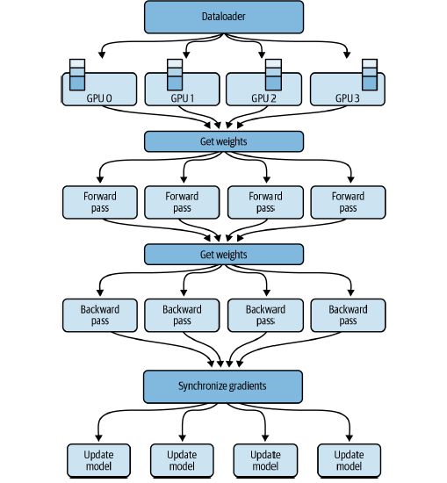
Distributed Computing (Fully Sharded Data Parallel)
ZeRO: Memory Optimizations Toward Training Trillion Parameter Models → https://arxiv.org/pdf/1910.02054.pdf
https://lightning.ai/docs/pytorch/stable/advanced/model_parallel/fsdp.html

